Slide 1
Exercise 2 Segmentation using HSV
-Dhiren Gupta
800902466

Slide 2
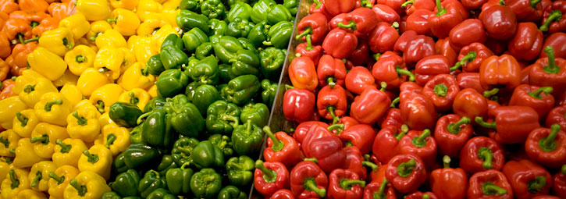
Original Image
Original

Slide 3
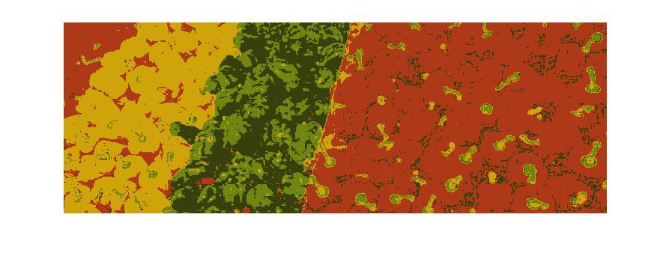
N=5

Slide 4
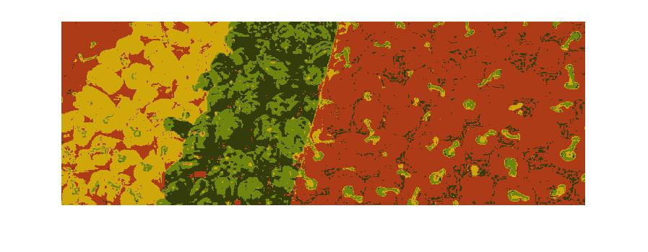
N=1

Slide 5

Sample N=10

Slide 6
Analysis
After segmentation images our blur as compare to original image. But we are able to identify the color section.
As we increase the number of inputs, it means we are taking more samples to identify the HUE range. Colors are more accurate
For higher sample N=10, color in each section is more visible, which were not clear in N=1;
We can easily identify more color shades for more no of samples.

Slide 7
Thank You

